Slide 1
Brain metabolome analysis of a familial Alzheimers disease-like mutation in the zebrafish presenilin 1 gene.
Client: Michael Lardelli, Morgan Newman
MA: Brunda Nijagal
Kim Kwan

Slide 2
Introduction
Alzheimer’s disease (AD) is the most common form of dementia with severe personal, social, and economic impacts.
ALZHEIMER'S DISEASE
Early Onset (<65 years)
Alzheimer’s Disease
2%
Late Onset (>65 years)
Alzheimer’s Disease
98%
Familial Alzheimer’s Disease (fAD)
(Dominant inheritance)
fAD genes:
PSEN1, PSEN2,
APP, SORL1
Sporadic Alzheimer’s Disease
Risk loci:
APOE, CLU, CR1, PICALM, TREM2, BIN1, ABCA7, SORL1
Risk Factors:
AGE, cardiovascular risk factors,
head trauma, diabetes
Notes:
RARE EARLY ONSET AD:
Rare, early onset familial forms of AD (EOfAD) are caused by autosomal dominant mutations in single genes.
is thought to develop over decades with an onset age of 45 years.
Functional MRI of human children carrying EOfAD mutations in PSEN1 has revealed differences in brain activity compared to non-carriers in individuals as young as 9 years of age.
Presumably therefore, heterozygosity for EOfAD mutations in PSEN1 causes early molecular changes/stresses that eventually lead to AD.
LATE ONSET:
More common form and sporadic with no clear genetic pattern,
it is complex with a number of genes discovered through GWAS studies as risk factors. The strongest risk factor is age and more and more evidence suggests lifestyle factors such as diet and exercise are also playing a major role in diesase development. However how these feed into the amyloid hypothesis or cause neuronal death is still hotly debated.
How do these genes and risk factors lead to AD?

Slide 3
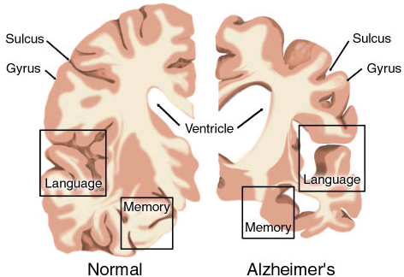
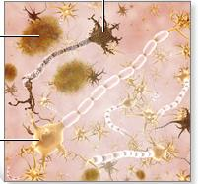
Current definition of Alzheimer’s disease (AD)
Tau Tangles
Amyloidβ
aggregates
Dying
neuron
Healthy
neuron
Amyloidβ in Alzheimer’s disease:
Aβ oligomers are neurotoxic
Aβ levels increase ~20 years before disease onset
Mutations in the genes causing familial Alzheimer’s disease can alter the production of Aβ
Many brain pathologies:
Vascular dysregulation
Mitochondrial dysfunction
Altered glucose metabolism
Inflammation
Structural & functional brain changes observed in young pre-pathology PSEN1 mutation carriers
Notes:
…are lots of changes at the physiological level,
which include things like decreased glucose metabolism and inflammation.
At the molecular level, the most characteristic feature of Alzheimer’s disease, is high levels of a protein called amyloid beta. Amyloid beta can aggregate to form dense plaques like this one here.
It’s considered a unique feature of Alzheimer’s disease, and there are several key findings that suggests that it plays an important role in Alzheimer’s disease. So it’s clearly toxic to the brain. It’s also one of the earliest biomarkers of Alzheimer’s disease.
While most people develop Alzheimer’s disease sporadically, without any clear single cause,
As shown in the previous slide some people inherit a highly penetrant, autosomal dominant mutation, that causes Alzheimer’s disease.
We call these cases familial Alzheimer’s disease.
The mutations causing familial Alzheimer’s disease are in genes coding for proteins that are involved in the production of amyloid beta, and these mutations tend to increase amyloid beta accumulation. Again, this supports the idea that amyloid beta plays an important role in Alzheimer’s disease.
Vascular dysregulation is an early pathological event during disease development
Each cerebral hemisphere is divided into four lobes by sulci and gyri. The sulci (or fissures) are the grooves and the gyri are the "bumps" that can be seen on the surface of the brain. The folding created by the sulci and gyri increases the amount of cerebral cortex that can fit in the skull.

Slide 4
Why Zebrafish?
Transgenic and “knock-in” Mouse models of EOfAD mutations have not shown the desired histopathologies.
AIM: To create a genetic state as similar as possible to the EOfAD state in humans.
Histopathologies central to the disease process, i.e. amyloid plaques & neurofibrillary tau tangles
Notes:
A wide variety of transgenic models of AD have been created and studied.
Aimed at reproducing histopathologies: amyloid plaques and neurofibrillary tau tangles.
Zebrafish have provided a simplified approach. The lab has engineered mutations into the endogenous familial Alzheimer’s disease genes of zebrafish. We have analysed young, pre-pathology mutant zebrafish brains to discover the early changes caused by the mutation. We are aiming to follow up with analyses of aged mutant brains to see if the early changes persist or differ during aging.
We have taken a number of approaches to analysing the brains of our familial Alzheimer’s disease-like mutant zebrafish. In my poster I am presenting work on how mutant zebrafish brains respond to low oxygen or hypoxia.

Slide 5
Zebrafish models of fAD mutations
PSEN2 N141I
Psen1 (Psen2)
Sorl1
T141_L142
and N140fs
in psen2
K97fs
in psen1
A121fs
W233_T234delins
in psen1
Q96_K97del
in psen1
VPS10P
C1481fs
LDLR Class B
PSEN1 T440del
LDLR Class A
T429del
in psen1
W1818Ter
FNIII Repeats
Transmembrane domain
S4Ter
in psen2
N7fs “null”
in psen1
Appb
R5fs “null”
Notes:
As mentioned earlier the early onset familial forms of AD (EOfAD) are caused by autosomal dominant mutations in single genes.
Majority of these mutations occur in the gene PRESENILIN 1 (PSEN1) that encodes a multipass integral membrane protein.
To start with the group investigated the early transcriptomic changes the mutation caused in young, pre-pathology mutant zebrafish brains.

Slide 6

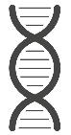
Transcriptomics analysis
X
fAD-like
non-mutant
genome
editing
mutation causing
familial Alzheimer’s
disease (fAD)
young
Transcriptomic analysis indicates that the psen1fAD-like mutation has significant impacts on cellular energy metabolism and transmembrane transport processes
Notes:
Study design

Slide 7
Transcriptomic analysis indicates that the psen1fAD-like mutation has significant impacts on cellular energy metabolism and transmembrane transport processes

Slide 8
Why Metabolomics?
Historically believed that decreased neuronal metabolism is a hallmark feature of Alzheimer's disease (AD).
‘omic’ technologies provide the most in-depth insight possible into the molecular and functional states of cells and tissues.
Notes:
The Lardelli lab want to know molecular mechanisms underlying changes in the brain.
And this is where we came into the picture.

Slide 9
Metabolomics analysis
What are the molecular mechanisms underlying changes in the Alzheimer’s disease brain?
X
heterozygous
fAD-like mutant
genome
editing
non-mutant
mutation causing
familial Alzheimer’s
disease (fAD)
molecular
analyses
young
molecular
analyses
aged
*We analyse siblings from the same tank to minimise genetic and environmental variation*
Our approach is to model the human fAD genetic state as closely as possible

Slide 10
Study Details
Total number of samples n=12
Conditions:
Analysis: Polar metabolite analysis using LCMS_HILIC (negative mode).
Instrument: Agilent Q-TOF 6545B
Data analysis: Agilent Mass Hunter TOF Quant.
Data statistic analysis for quality check: MetaboAnalyst.
Sample ID | Label on tube for the 2 brains to be pooled | Gender | Age
WT 1 | 3 and 5 | male | 6 months
WT 2 | 6 and 7 | male | 6 months
WT 3 | 8 and 9 | male | 6 months
WT 4 | 15 and 18 | male | 6 months
WT 5 | 26 and 28 | male | 6 months
WT 6 | 30 and 31 | male | 6 months
Q96 1 | 4 and 10 | male | 6 months
Q96 2 | 13 and 14 | male | 6 months
Q96 3 | 16 and 17 | male | 6 months
Q96 4 | 19 and 21 | male | 6 months
Q96 5 | 23 and 27 | male | 6 months
Q96 6 | 29 and 32 | male | 6 months

Slide 11
Data Diagnostics: Full analysis (549 metabolites)
ISTD in PBQC and samples < 20% CV indicate optimal extraction efficiency & instrument performance.
Intra-sample %CVs are higher due to biological matrix variability.
166 polar metabolites (out of 549 present in the standard mixes 1-13 library) were detected in samples, with many resolving well (< 10% CV).
 | Coefficient of variation (%CV)
ISTD | Samples (n=12) | PBQC (n=6)
13C,15N-UMP | 9.7 | 7.3
13C10,15N5-AMP | 5.0 | 2.2
13C5,15N1-Valine | 2.2 | 1.9
13C6-Sorbitol | 7.6 | 6.3
% CV in PBQCs (n=6) | Metabolites (166)
<10 % | 98
10-20 % | 35
20-30 % | 24
> 30 % | 9
 | Metabolites
Total metabolites in Polar stds library | 549
Total metabolites detected | 166
Total internal standards | 4

Slide 12
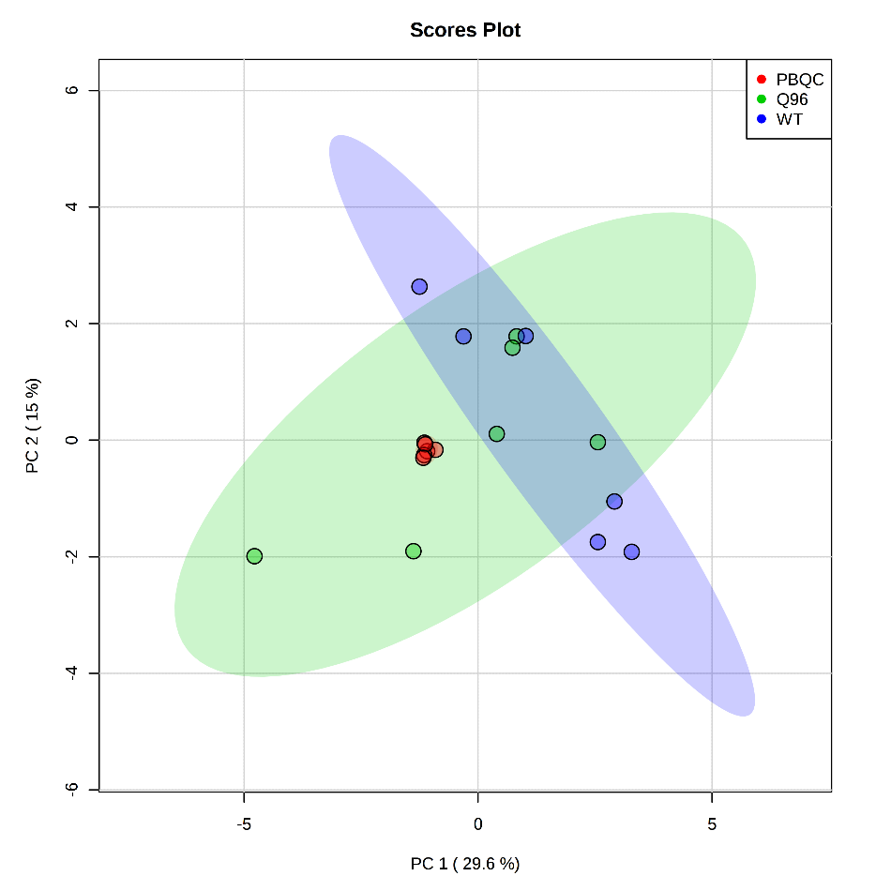
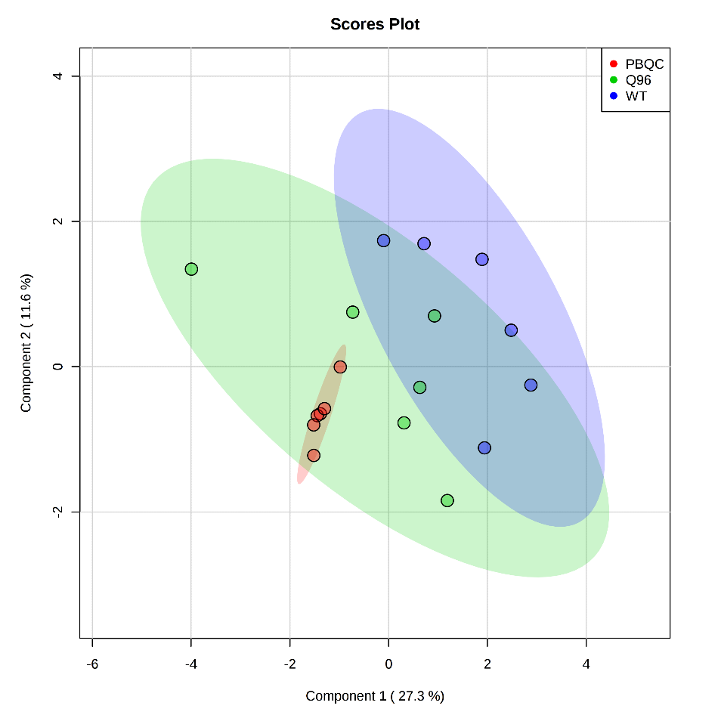
Statistical Analysis All data: Median normalised + Log transformed
PCA
PLSDA
PBQCs
PBQCs are clustered central between other conditions.

Slide 13
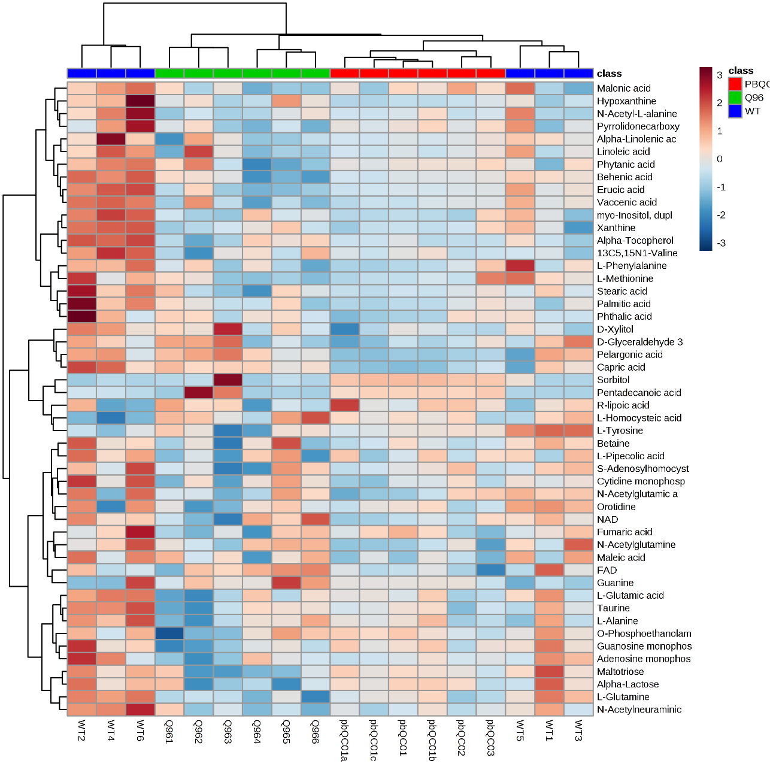
Heatmap Top 50 ANOVA/T-test: Median normalised + Log transformed
Found:
L-Glutamine to be significantly different (FDR adjusted p <0.05) between the two groups.
Large metabolic variation in the MT group.
Extraction (ISTDs) and Instrument QCs were great.
Notes:
with half the WT brains presenting different metabolic signatures.

Slide 14
Top 15 metabolites, ranked by p-value.
Metabolite | t-statistic | p-value | FDR p-value | fold-change
L-Glutamine | -5.2682 | 0.00036372 | 0.046921 | 0.84978
Erucic acid (C22:1) | -4.0538 | 0.0023093 | 0.14895 | 0.75479
Maltotriose | -3.6354 | 0.0045716 | 0.18578 | 0.63114
Behenic acid (C22:0) | -3.4251 | 0.0064911 | 0.18578 | 0.75804
Guanosine monophosphate | -3.3482 | 0.0073874 | 0.18578 | 0.82026
N-Acetylneuraminic acid | -3.2197 | 0.0091794 | 0.18578 | 0.82442
L-Methionine | -3.1645 | 0.010081 | 0.18578 | 0.74336
L-Glutamic acid | -3.023 | 0.012829 | 0.20687 | 0.90126
Vaccenic acid/Oleic Acid (C18:1) | -2.9313 | 0.015008 | 0.21511 | 0.82176
Alpha-Lactose | -2.835 | 0.0177 | 0.22833 | 0.65024
L-Phenylalanine | -2.6468 | 0.024445 | 0.26666 | 0.77087
Adenosine monophosphate | -2.6383 | 0.024806 | 0.26666 | 0.86594
Taurine | -2.3651 | 0.039609 | 0.39304 | 0.90067
L-Homocysteic acid | 2.1793 | 0.05431 | 0.50042 | 1.4217
Notes:
ma

Slide 15
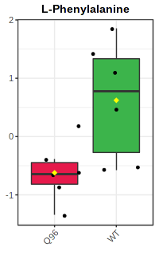
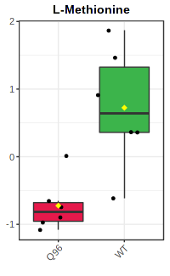
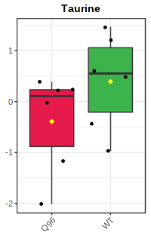
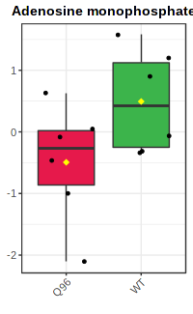
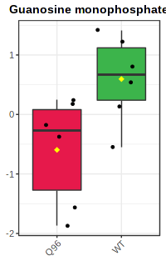
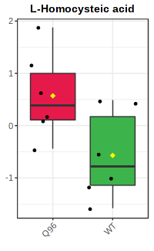
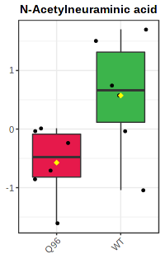
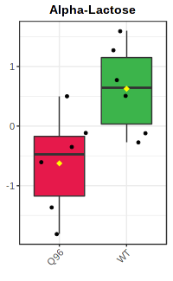
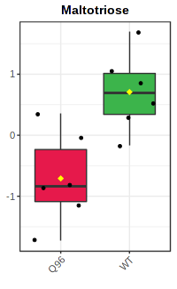
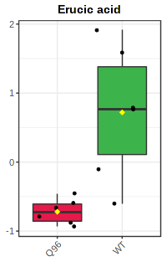
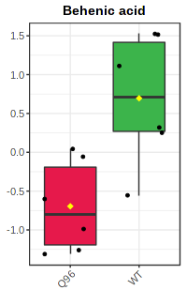
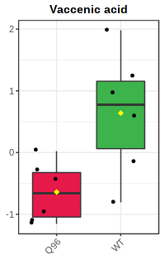
Boxplots

Slide 16
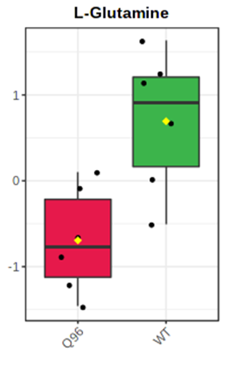
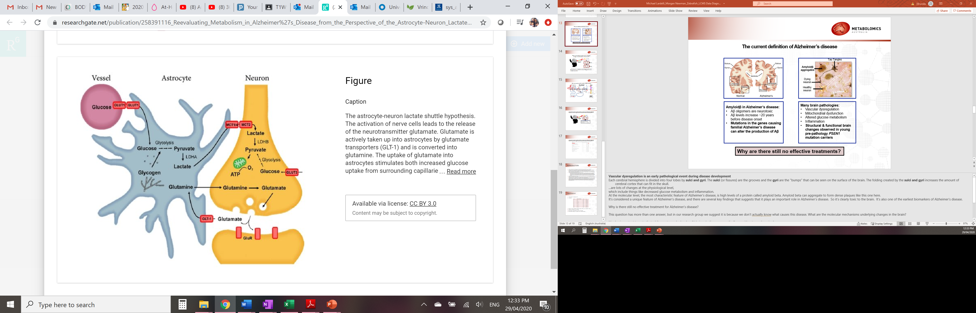
Glutamine
https://www.hindawi.com/journals/jnd/2013/234572/
The difference in L-glutamine levels is very interesting, particularly considering the central role that this metabolite plays in the relationship between neurons and the astrocytes that support them.

Slide 17
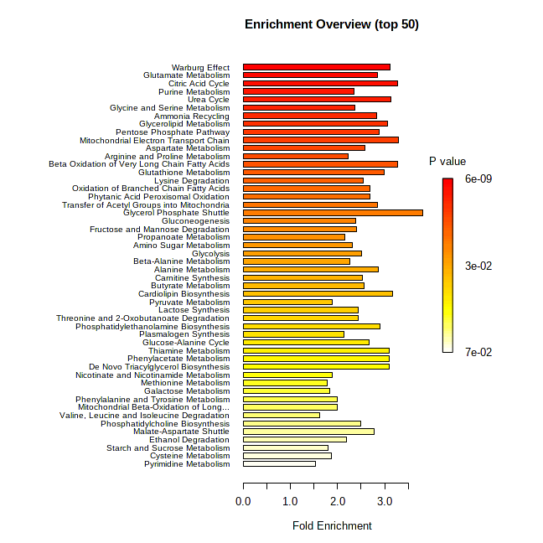
Pathway enrichment
Notes:
Just to show which pathways were enriched in this study.

Slide 18
Conclusion
Large metabolic variation in the MT group.
All at different stages of manifesting the impact of the mutation
The L-Glutamine is a stand-out. Along with Glutamic acid initial changes in neuron-astrocyte
Notes:
Despite the
We are analysing full brain tissues and not taking into account:
- different cellular compartment of the brain that all have specific needs.
- Different cell types in the brain (for instance the Warburg effect) maybe a contribution from inflammation cells.
Unfortunately lactate was not detected in these samples.
Aerobic glycolysis, also known as the Warburg effect, is defined as glucose utilization in excess of that used for mitochondrial respiration despite sufficient oxygen to completely oxidize glucose for maximal ATP generation. A by-product of aerobic glycolysis is lactate, a metabolite which is normally exported out of cells.

